Slide 1

PHISHING DETECTION IN WEBSITES USING RANDOM FOREST ALGORITHM
PRESENTED BY:
Dinesh reddy N(192224107)
Suraaj Simha R(192224098)

Slide 2
PHISHING DETECTION IN WEBSITES
ABSTRACT
INTRODUCTION
OBJECTIVES
TYPES OF PHISHING
EXISTING AND PROPOSED SYSTEM
CONCLUSION

Slide 3

ABSTRACT
WHAT IS PHISHING?
In computer security, phishing is the criminally fraudulent process of attempting to acquire sensitive information such as usernames, passwords, and credit card details.
PHISHING is a new type of network attack where the attacker creates a replica of an existing web page to fool users into submitting personal, financial, or password data to what they think is their service provider’s website.
It is a type of social engineering attack that takes place when a malicious website impersonates a legitimate website to gain sensitive user information, such as passwords, and account information.
Phishing websites typically collect personal data, login credentials, or financial information, which can be used for identity theft, financial fraud, or other malicious purposes.

Slide 4
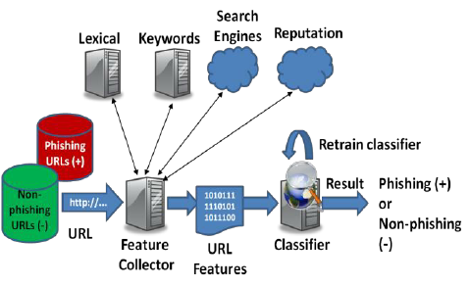
INTRODUCTION
PHISHING DETECTION:
A basic phishing attack attempts to trick a user into entering personal details or other confidential information, and email is the most common method of performing these tasks.
Phishing detection schemes can work on the client side without any server deployment or can work on the server side and provide necessary information to thin clients who might not have enough resources to deploy Phishing detection logic.
Phishing detection schemes and identified that they can be classified as
(1) Search engine based schemes, (2) Machine learning based schemes
(3) Blacklist and Whitelist based techniques, (4) Visual similarity matching schemes
(5) DNS-based schemes (6) Email extensions and (7) scheme for mobile devices.
Even then, online users are being trapped into revealing sensitive information in phishing websites.

Slide 5





PHISHING ATTACK ANALYSIS
TEXT ANALYSIS
URL ANALYSIS
DOMAIN ANALYSIS
ANAMOLY DETECTION
IMAGE ANALYSIS
ML can analyze the text in emails or on websites.
Analyze the structure and content of URLs to identify them.
ML models can identify discrepancies and abnormalities.
Recognize patterns of normal activity and anomalies.
CNNs can be trained to analyze images on websites.

Slide 6
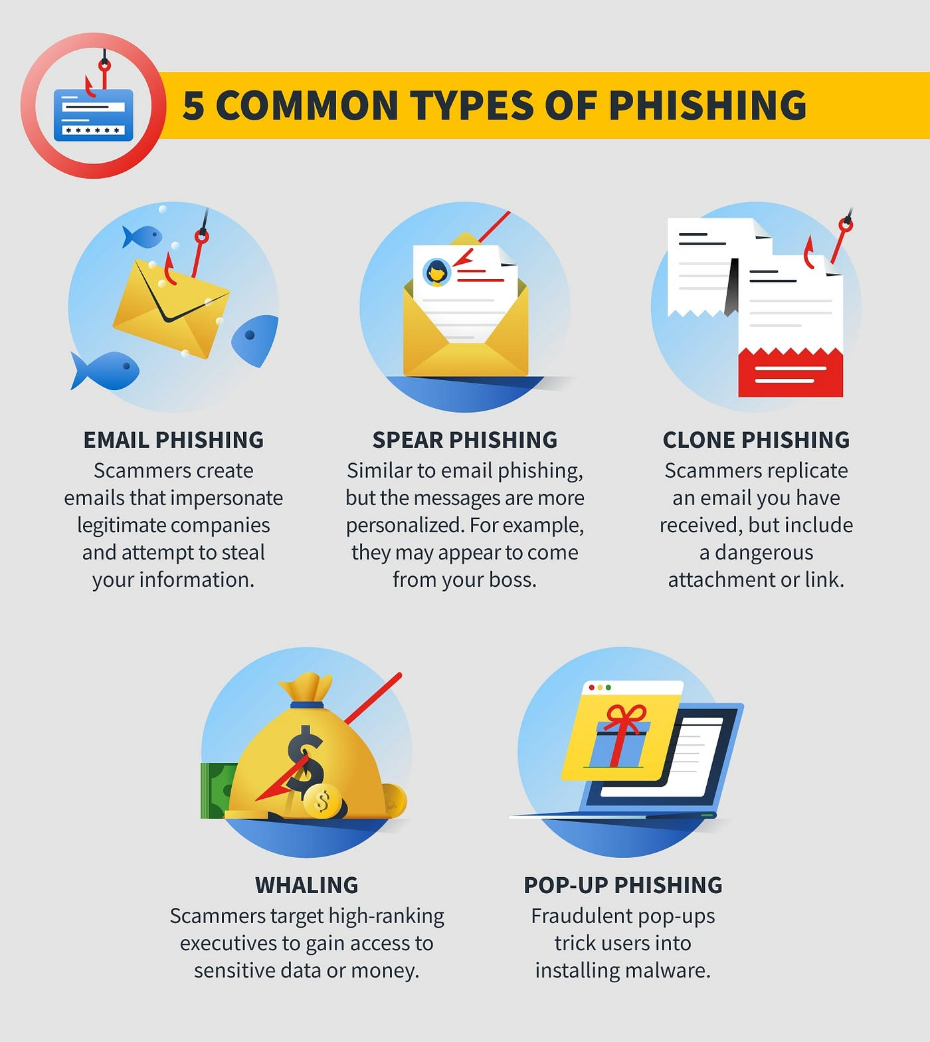

TYPES OF PHISHING
CATEGORY 1
CATEGORY 2
Add text here.
Add text here.
CATEGORY 3
CATEGORY 4
Add text here.
Add text here.
CATEGORY 5
CATEGORY 6
Add text here.
Add text here.

Slide 7
OBJECTIVES
PURPOSE OF STUDY:
Develop accurate classification models.
Feature extraction and selection.
Model evaluation and performance metrics.
Handle imbalanced data.
Optimize model performance.
Documentation and reporting.
Build trust in online interactions.
Protect privacy.
Reduce Financial Losses.

Slide 8
EXISTING TECHNIQUES FOR PHISHING DETECTION
LIST BASED TECHNIQUES:
Modern browsers
Whitelist and blacklist
Heuristic-based techniques:
Features extracted from phishing websites.
Visual Similarity based approach:
Compare suspicious website image
Used when similarity score is greater than a certain threshold.
Machine-learning based techniques:
Combination of heuristic and machine learning algorithms.
Installing online anti-phishing software in user’s computers.
Enhance the security of the websites.

Slide 9
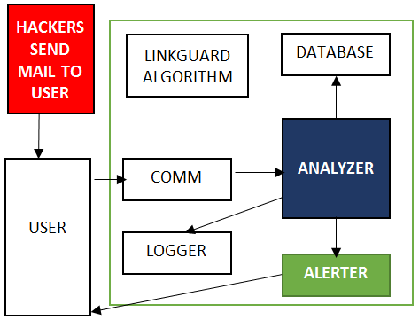
PROPOSED SYSTEM
COMM
Database
This collects information on the input process and sends this related information to the analyzer.
Store the white list, blacklist, and the user input URLs.
Analyzer
ALERTER
It is the key component of Link Guard, which implements the link guard algorithm; and sends the results to the alert and logger modules.
When receiving warning messages from analyzer, it shows the related information to alert the users and send back the reactions of user back to the analyzer.
Logger
Link guard
Archive the history information, such as user events, alert information, for future use.
Finds the phishing emails.

Slide 10
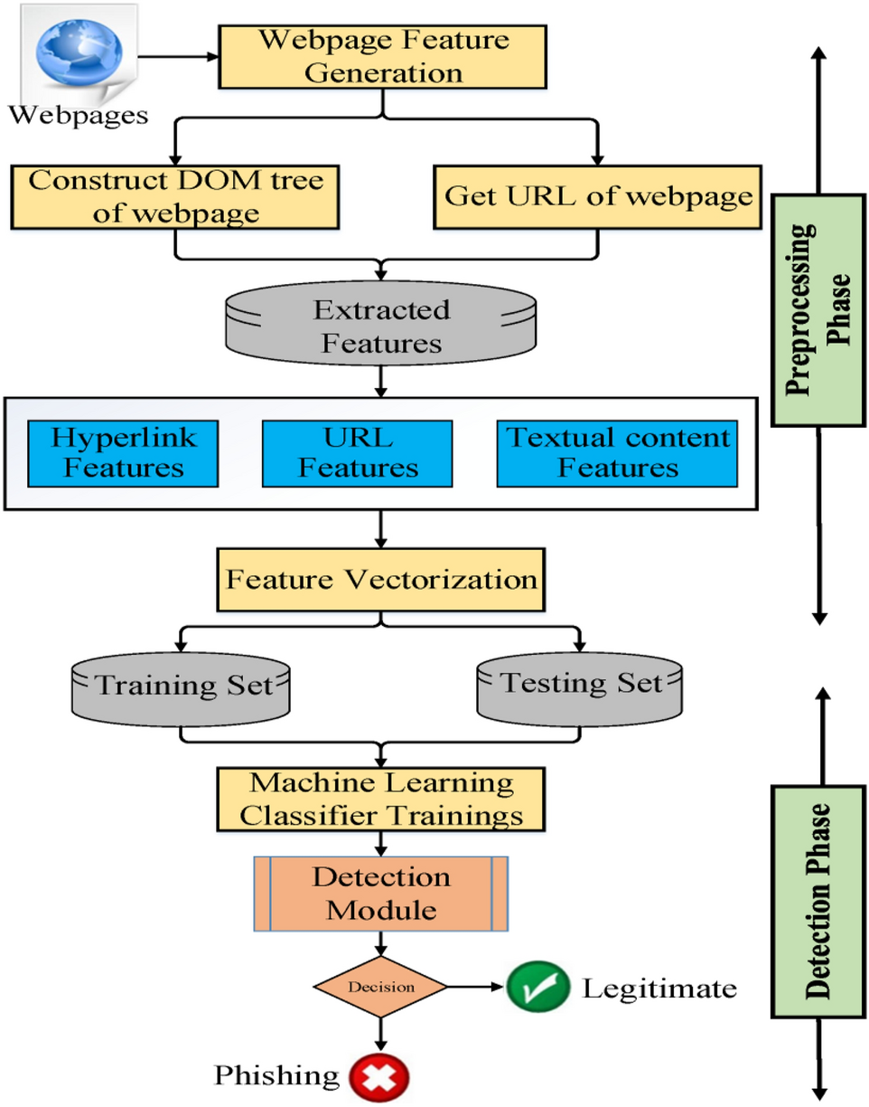
MACHINE LEARNING MODELS
This is a supervised machine-learning task. There are two major supervised machine learning problems, called classification and regression.
This data comes under a classification problem, as the input URL is classified as Phishing(1) and legitimate(0). The machine learning models (classification) are considered to train the dataset.
The random forest algorithm is a supervised classification and regression algorithm. This algorithm, as the name implies, generates a forest with various trees at random.

Slide 11
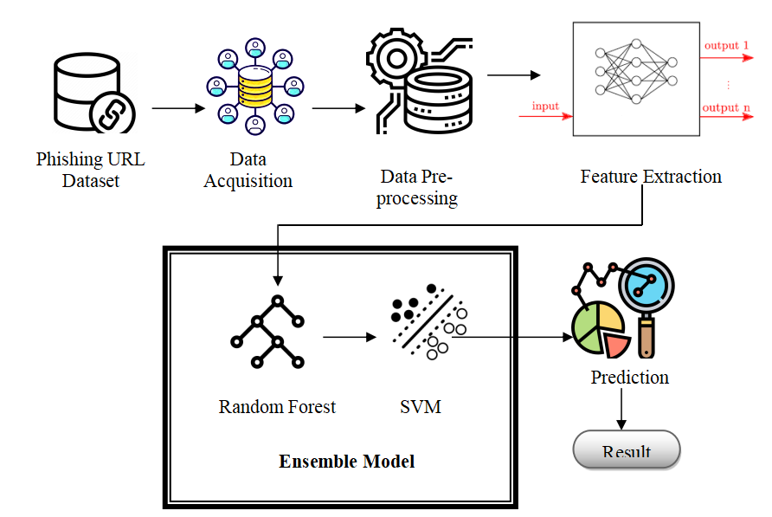
MACHINE LEARNING MODELS
Begin by randomly selecting samples from a given dataset This method will then build a decision tree for each sample. The forecast result from each decision tree will then be obtained.
Random forests perform better than single decision trees for a wide range of data items.
The variance of a random forest is lower than that of a single decision tree Random forests are extremely adaptable and accurate.
Even when a major amount of the data is missing, the Random Forest method maintains good accuracy.

Slide 12

CONCLUSION
Detecting phishing attempts is crucial for safeguarding individuals and organizations against cyber threats.
By employing advanced detection techniques, including machine learning algorithms, behavioral analysis, and real-time monitoring, we can effectively mitigate the risks associated with phishing.
Continuous education and awareness programs also play a pivotal role in empowering users to recognize and report phishing attempts promptly.
Through these combined efforts, we can enhance cybersecurity resilience and protect sensitive information from malicious actors seeking unauthorized access.

Slide 13


